Slide 1
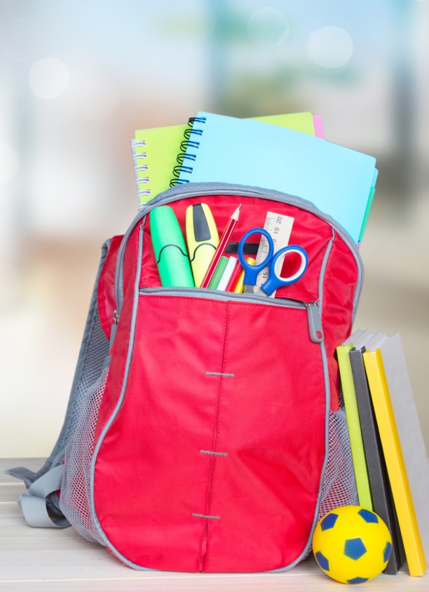
Ellicott Mills Middle School 에 오신 것을 환영합니다
백 투 스쿨 나잇
Notes:
Cover slide [insert school name]

Slide 2
비전: 모든 학생과 교직원은 다양성을 포용하고, 보다 큰 커뮤니티에 긍정적 영향을 미칠 수 있는 자질과 지식, 자신감을 갖춥니다.
사명: HCPSS는 기회 격차를 줄이는 포괄적이며 양육적인 환경에서 각 학생이 학업적 성공과 사회-정서적 웰빙을 확실하게 갖도록 합니다.
VALUE
ACHIEVE
EMPOWER
CONNECT
보다 자세한 정보: www.hcpss.org/scta
Notes:
Superintendent Michael Martirano has established a bold Strategic Call to Action to guide our school system. “Learning and Leading with Equity” is a strategic plan for building an instructional program to enable every student to reach their greatest potential.
HCPSS is focusing our resources and priorities to make certain that every child graduates from high school and is prepared for the world of work and ready to enter college.
The Strategic Call to Action embodies four commitments to each student, staff member, parent, and community member:
We VALUE every stakeholder, whether student, employee, parent, or community member.
We commit to ACHIEVEMENT by supporting every person in our system - both students and staff - in reaching milestones for personal growth that are appropriate to their goals and strengths.
We CONNECT with students, parents and community members in ways that nurture and restore.
We EMPOWER schools, employees, families, and community members to actively support student achievement and well‐being.

Slide 3
학교와 교육청의 뉴스 및 정보
이메일
문자 메세지
학교 소식, HCPSS 소식,
비상 통보
긴급/비상 통보만
HCPSS 웹사이트
학교 웹사이트 XXXX.hcpss.org
www.hcpss.org
교육청 뉴스와 정보 자료
학교 소식, 달력, 스포츠 및 동아리, 교직원 명부; 기타
Notes:
[Fill in on slide (lower right): your school name & web address initials]
Parents receive news and announcements from our school and system via the HCPSS News service. Parents are automatically registered for this service. Email messages are delivered to the contact information that you provide in the Family File.
Parents receive via Email:
School newsletters & other communications
Major system-level announcements
HCPSS News weekly newsletter, providing news and upcoming events.
Emergency notifications (school closings/delays).
Text messages: Parents have the option to receive text messages. Texts are sent only for urgent/emergency announcements (school closings and delays, etc.)
New parents are sent a text message to opt-in for text alerts. If you didn’t receive this, visit www.hcpss.org/hcpss-news/ to troubleshoot.
Text alerts will be sent to the mobile phone number identified in Family File.
If you were opted-in to receive text messages last year, and your phone number has not changed, you do not need to opt-in again.
Our school website is a one-stop destination where you can quickly find:
School calendar, announcements and news
Student activities, sports, clubs
Services including school meals
Staff directory and email links
Quick Links to HCPSS Connect, system website, and other resources for students and parents

Slide 4
소셜 매체
[School name] 트위터: @hcpss_xxxx
HCPSS 페이스북: www.Facebook.com/HoCoSchools
HCPSS 트위터: www.Twitter.com/HCPSS
HCPSS 인스타그람: instagram.com/hocoschools
HCPSS 플리커: flickr.com/photos/hcpss
교육감의 트위터: https://twitter.com/mjmsuper
Notes:
[insert school name & Twitter handle on slide if actively using it; remove 1st line if not]
Link to our social media sites:
Get up-to-the-minute updates, news, student and school happenings, and announcements
Interact with the school and system

Slide 5
주간 교육청 이메일
교육청 뉴스와 공지사항
다가올 행사
HCPSS의 정책 및 결정에 대한 생각을 나눌 기회
Notes:
Watch your inbox for HCPSS News each week throughout the school year.
The HCPSS News weekly email is your source for announcements of
Upcoming school system programs and events
Public Hearings and other opportunities to share input and feedback
Opportunities to participate on school system committees
Boundary Review updates, and other important information.
All parents are automatically subscribed to HCPSS News.

Slide 6
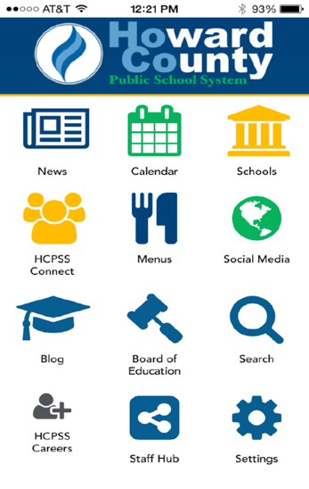
HCPSS 모바일 앱
앱 스토어에서 무료 다운로드:
아이폰 iPhone
아이패드 iPad
안드로이드 Android
Notes:
The HCPSS Mobile App is available free to download for iphones, iPad, and Android devices in the app stores (search for “HCPSS”).
The app makes it quick and easy to find the information you need, when you need it. It provides:
Messages and calendar dates from all of the schools that your children attend, as well as school district information.
School menus
Simplified access to information and quick links

Slide 7
학교 휴교/지연 정보
www.HCPSS.org
@hcpss
HCPSS 뉴스
HoCoSchools
HCPSS 상황
직통 전화
status.hcpss.org
410-313-6666
Notes:
School Delays and Closings (usually weather-related) are communicated through several information sources:
HCPSS homepage: www.hcpss.org - this is the first and most complete source of information
HCPSS News emails and texts (as described on earlier slide)
Social media: Twitter (@hcpss) & Facebook (HoCoSchools)
HCPSS TV – channel 42 (Verizon) and 72 (Comcast)
HCPSS Information Hotline recording – 410-313-6666

Slide 8
정신 건강 및 학생 지원
학교 상담교사: Rachel Schwaab – Last Names A-G
(rachel_schwaab@hcpss.org)
Shanté Owens-Young – Last Names H-O
(shante_owens-young@hcpss.org)
Grace Burnett – Last Names P-Z
(grace_burnett@hcpss.org)
학교 심리학자: Mary Kate Dorval (marykate_dorval@hcpss.org)
국제 성취 연락관: Sung Kim (sung_kim@hcpss.org)
보다 자세한 정보: www.hcpss.org/supports/mental-health-wellness
Notes:
Replace [school name] and names/contact info (phone and/or email) for your school’s student support staff members (add/delete titles as needed)
The mental health and well-being of our students is very important to us. Staff are available to support students and families. These staff work with all students to develop their unique strengths and abilities.
Each of these staff members wants to work with parents to best support your child. Please do not hesitate to contact them with questions or concerns.
The “Mental Health and Wellness” page on the HCPSS website provides many valuable resources for all families. Search for “mental health” at www.hcpss.org.

Slide 9
Synergy 학생 정보 시스템
Canvas
학습 시스템
가족 파일
www.hcpss.org/connect
Notes:
HCPSS Connect is the one-stop portal to access Synergy, Canvas, and the Family File.
The Synergy Student Information is your source for official student records & grades.
The Canvas Learning System gives teachers, parents, and students tools to communicate, collaborate, and connect.
Both systems are extremely easy to learn and to use.
Benefits of HCPSS Connect for Parents, Students & Teachers:
Improved communication and collaboration
All schools and grades use the same digital platform
Single sign-on - 1 user/pass for HCPSS Connect
Anytime/anywhere access
Find full details and instructions online at www.hcpss.org/connect

Slide 10
학생 정보 갱신하기
부모 연락 정보
의료 자료 및 연락처
방과 후 교통편
데이터 개인정보보호 선호도
운동 참가서
www.hcpss.org/connect
Notes:
The Family File on HCPSS Connect provides important information about your student. All information is confidential.
It is important that parents update the Family File each year with current data about your student including:
Parent emails and phone numbers
Student medical contact data
After-school transportation options
Data privacy options
Links to the application for the Free and Reduced Meals program
Log into HCPSS Connect and click the My Account tab. Save your changes by clicking the Update Account button.
Parents can make changes in the Family File at any time during the year.
Parents without online access can provide this information through a paper “Emergency Procedure and Confidential Student Information” form. Contact the school office for a copy of this form.
Athletic participation forms can be completed online in Synergy.

Slide 11
HCPSS Connect: 도움받는 방법
로그인 지원:
학교 교무실로 연락
안내 및 자료들:
www.hcpss.org/connect
Notes:
Parents will continue to use the same login credentials as in prior years.
Parents of students new to HCPSS will receive their login information via US Mail.
For help with your login or password: call the School Office
For help in using Canvas, Synergy, or the Family File, see the many guides and resources on the HCPSS Connect homepage (www.hcpss.org/connect), or contact the school office.

Slide 12
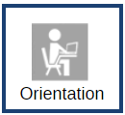
Canvas: 담긴 내용
홈페이지:
개요
학생 개인정보보호
자료들
달력 날짜/행사
광고
(학년에 맞는) 학생의 자질 구축
CANVAS
Canvas에 대해 궁금한 것 있으신가요? Canvas 홈페이지에 있는 Orientation 박스를 눌러 부모님을 위한 안내(Parent Guides)를 확인해 보십시오.
Notes:
Canvas is HCPSS’ Learning Management System. In elementary school, teachers primarily use Canvas to share general course information and resources, send out announcements, and share calendar events. Your child’s classroom teacher may publish their individual ELA or Math courses, or they may work as a grade-level team and share information from the grade-level page. In upper-elementary grades, your child’s teacher may use more of Canvas’s other tools, such as online discussion boards, quizzes, and digital assignment submissions.
CANVAS EXPECTATIONS for teachers:
Each Canvas course will have the following:
Course homepage
Overview - Information about the course and teacher or about the grade-level team
Student privacy information - Information on homepage or grade level page regarding teachers’ use of recording devices and digital tools for school-related activities
Resources - Links to instructional tools or resources for families
Calendar dates - Share class/grade specific dates and events with families and students using the Canvas calendar
Announcements – Teachers will communicate timely information with students and families using announcements either through the teacher course or grade level course. By default, announcements will be sent to parent’s primary email in Family File
In addition, teachers will help students develop their Canvas and online learning skills with grade-appropriate activities.
Parents can learn more about how to use Canvas by going to the Canvas Orientation course (link at the top of the Canvas homepage). There, they can learn how to navigate Canvas and change their notification preferences.

Slide 13
상호작용적인 학교 급식 메뉴
음식에 대한 설명
영양소와 알레르기 항원
탄수화물 계산
선-지불 링크
FARMS 신청서 링크
조식과 점심 메뉴
http://hcpss.nutrislice.com
iPhone 이나 IOS로 받는 무료 앱
HCPSS 모바일 앱
Notes:
HCPSS offers online school menus through a website and mobile app by Nutrislice.
The interactive menus provide access to up-to-the-minute content anytime, anywhere.
The innovative school menu site features nutrition and allergen information for all Howard County school meal items, both breakfast and lunch, and includes:
Carb counts
Allergen filters
Food descriptions and photos
Menu item rating system
Links to MySchoolBucks pre-payment options
Monthly menu email subscription sign-up
And more
Menus are available in several languages: English, Spanish, Korean, Chinese, and French.
Options for using the interactive menus:
Online: hcpss.nutrislice.com
Download the free app, “School Lunch by Nutrislice,” in the Google Play or App stores.
Select the “Menus” icon on the HCPSS mobile app

Slide 14
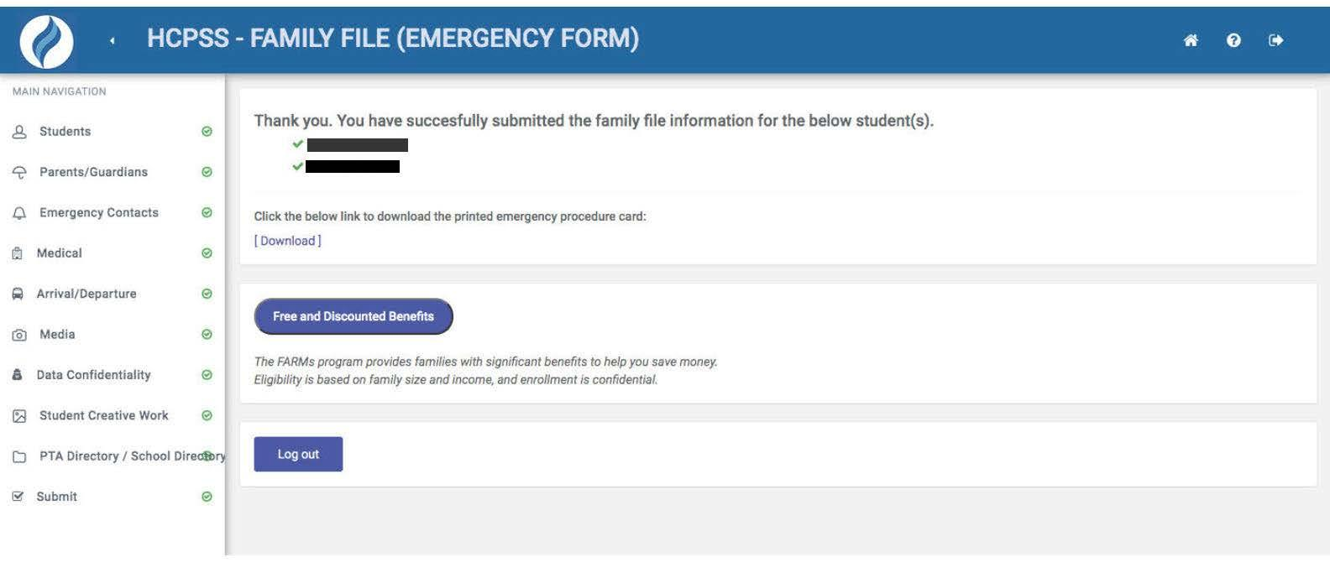
무료 및 할인 급식 (FARMs)
자격 요건이 되는 가정은 다음과 같이 무료 또는 할인 혜택을 받을 수 있습니다:
학교 급식
건강 보험
HCC 수업료
SAT, ACT 그리고 AP 시험 비용
캠프, 스포츠, 탁아
기타 다양한 혜택
Notes:
HCPSS participates in the National School Lunch and Breakfast Programs.
The Free and Reduced Price Meals program (FARMs) helps many families save money in many ways including free or lower prices for:
School breakfast and lunch
HCC tuition
SAT, ACT and AP exam fees
Camps, sports and child care
And many other programs and services
More information and the online application can be accessed at the completion of the Family File process.

Slide 15
무료 또는 할인 급식 (FARMs)
1단계: www.hcpss.org/farms/ 를 방문하기
2단계: “Apply Online”을 눌러 온라인 신청 절차 시작하기
HCPSS 웹사이트
신청
신청 방법
가구 당 신청서는 하나만 제출하십시오. 온라인 신청을 위한 컴퓨터나 언어 지원이 필요하시면 자녀의 학교로 연락하시기 바랍니다.
연방 소득 요건 안내를 보십시오.
온라인
온라인 신청서가 제출되고 검토되면 이메일/우편으로 적격성 여부에 대한 통보가 갈 것입니다.
신청 시작
신청 절차시 제공해야 할 것들:
가구 구성원 각각의 이름과 현재 수입
가구 내 모든 자녀의 학교와 학년
귀하의 전자 서명
(옵션) 신청 상태에 대한 지역간 소통을 위한 타당한 이메일 주소 또는 전화번호
시작할 준비가 되었으면, 아래의 버튼을 눌러 온라인 신청 절차를 시작하십시오.
온라인 신청 (추가 언어 사용 가능)
온라인 신청 절차 시작

Slide 16
귀하의 자녀가 배우게 되는 것에 대한 안내
HCPSS Connect 를 통한 Canvas에서
교과 내용 개요
학년별 (PreK – 5)
과목별
확인을 할 수 있습니다
www.hcpss.org/connect
Notes:
What Your Child Will Learn guides provide an overview of the instructional program for your child’s grade, as well as student goals and expectations. The guides include information to help parents monitor and support their child’s progress during the school year.
Individual guides are provided for each grade level. The guide identifies the content covered in each curriculum area, categorized by subject, e.g., Language Arts, Science, etc.
Find the guides online in Canvas. (The guides are available online only; print versions are no longer distributed.)
The guides provide general information about curriculum content. Specific student programs may differ, depending on instructional needs.

Slide 17
2020-2021 가을 학기 지침
정보와 갱신 내용:
www.hcpss.org/2020-2021/
자주 제기되는 질문들:
help.hcpss.org
Notes:
SCHOOL ADMINISTRATORS SHOULD CHECK ON THE HCPSS WEBSITE FOR UPDATES TO ALL OF THE FOLLOWING SLIDES BEFORE YOUR BTSN FOR UPDATES TO THIS INFORMATION. https://www.hcpss.org/2020-2021/
Detailed information about all aspects of the fall instruction program is provided on the HCPSS website.
You can find the answers to many questions on the help site: help.hcpss.org. The site is keyword searchable.
Check back frequently, as these sites are regularly updated with new information.

Slide 18
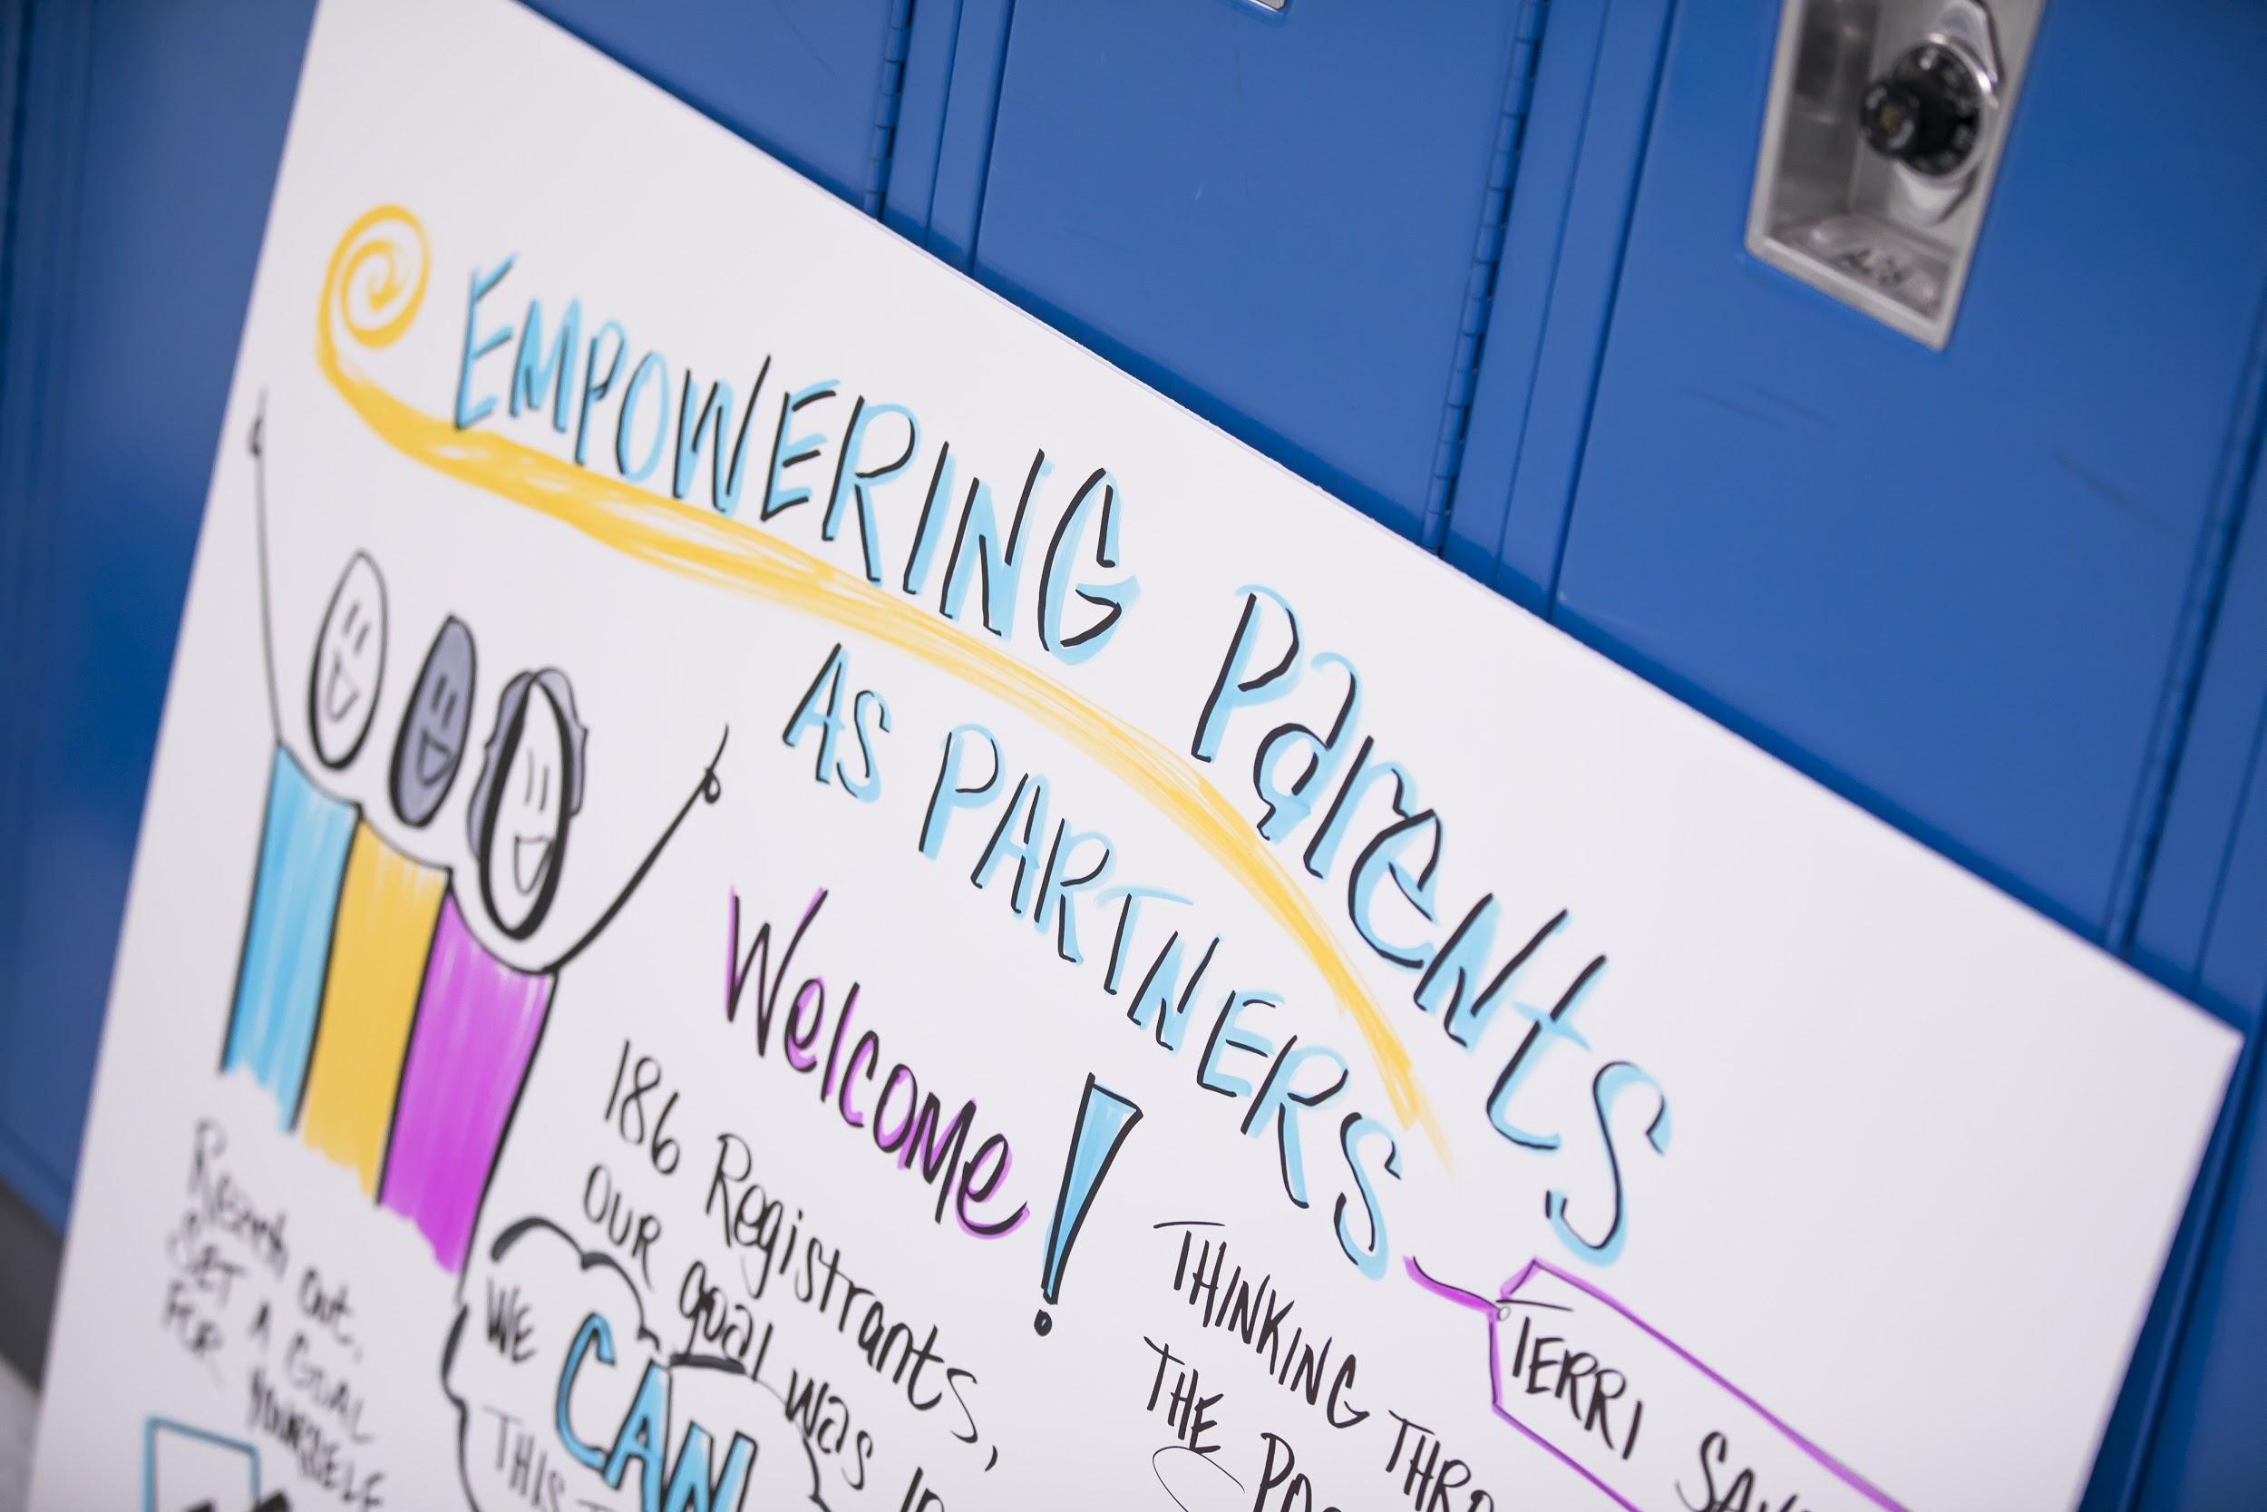
지역사회 자원들
하워드 카운티의 몇몇 기관에서 학생과 가족들을 위한 서비스 및 자원을 제공하고 있습니다.
www.hcpss.org/community-news-and-programs/
Notes:
There are several organizations in Howard County that offer services such as child care, tutoring and other supports and resources for students and families.

Slide 19
온라인 수업 스케줄 샘플
샘플 스케줄은 온라인으로 볼 수 있습니다.
www.hcpss.org/2020-2021/
Notes:
Students in grades K-5 will engage in synchronous lessons four days a week via Google Meet in Social Emotional Learning (SEL), language arts and mathematics.
Students will engage in content (science, social studies and health) via Google Meet two days each week.
Elementary students also will engage in related arts synchronous lessons via Google Meet two days each week.
Elementary students will engage in synchronous lessons 2.5-3 hours on each of the four synchronous days.
For each synchronous lesson, students are expected to participate in the lesson, respond to questions and participate in class activities.
In addition, students in grades K-5 will engage in asynchronous assignments, (e.g. independent reading, writing assignments, mathematics tasks and eLearning experiences with Lexia Core5 and DreamBox) for 8-9 hours each week.

Slide 20
출석
월요일, 화요일, 목요일 그리고 금요일
초등학교는 담임 교사와 수학 교사가 출석을 체크합니다
중학교와 고등학교는 각 수업 시 출석이 체크됩니다
수요일 (주중에 아래 사항 중 최소한 한가지 완료)
한 교사에게 과제 제출
HCPSS 교사와의 동시 발생 수업에 참여
Canvas 학습 관리 시스템이나, DreamBox 또는 Lexia Core5를 통해 과제 완료
Notes:
At the elementary level, student attendance for Monday, Tuesday, Thursday and Friday instruction will occur by both the homeroom teacher and mathematics teacher taking attendance, noting whether students were present online for synchronous instruction.
Daily attendance will be based on teacher-recorded attendance for the entire school day.
If there is technical difficulty, a student may submit asynchronous work for a particular day to receive credit for attendance.
For Wednesday, a student will be counted as present if they do one or more of the following at some point during the week:
Submit an assignment to one of their teachers
Engage in synchronous instruction or tutoring with an HCPSS teacher
Meet online with an HCPSS teacher or service provider
Complete work in the Canvas learning management system, DreamBox or Lexia Core5

Slide 21
점수 매기기
학생의 점수 매기기는 전통적인 채점 관행을 따를 것입니다.
부모님께서는 Canvas 에서 학업 수행 진전 상황을 점검하셔야 합니다.
Notes:
Student grading will follow the same traditional grading practices as followed during a typical school year.
Grading practices are outlined in HCPSS Policy 8010 – Grading and Reporting: Pre-Kindergarten Through Grade 5 and HCPSS Policy 8020 - Grading and Reporting: Middle and High School.
Staff are currently determining policy adjustments that may be needed for virtual instruction.

Slide 22
특수 교육 서비스
부모가 포함된 각 학생의 IEP 또는 IFSP 팀은, 학생의 현재 플랜이 2020-21 학년도에 어떻게 시행될지 논의합니다.
이전의 개별화된 지속적 학습(ICOL) 플랜은 더 이상 사용되지 않습니다.
온라인 수업 환경에서 어떻게 자녀들에게 최상의 서비스를 제공할 수 있을지에 대해 학년도 초에 부모님들께 연락을 드릴 것 입니다.
Notes:
A significant amount of thought and detail have been focused on ensuring that special education services and supports are provided to the greatest extent possible for students across all levels and schools.
Each student's Individualized Education Program (IEP) or Individual Family Service Plan (IFSP) team, which includes the parent, will be participating in meaningful discussions to implement the student’s current plan and not on the previous individualized continuity of learning, or ICOL, plans.
Parents should expect their child’s case manager to contact them at the start of the school year to collaborate on how best to provide services for their child in a virtual environment.

Slide 23
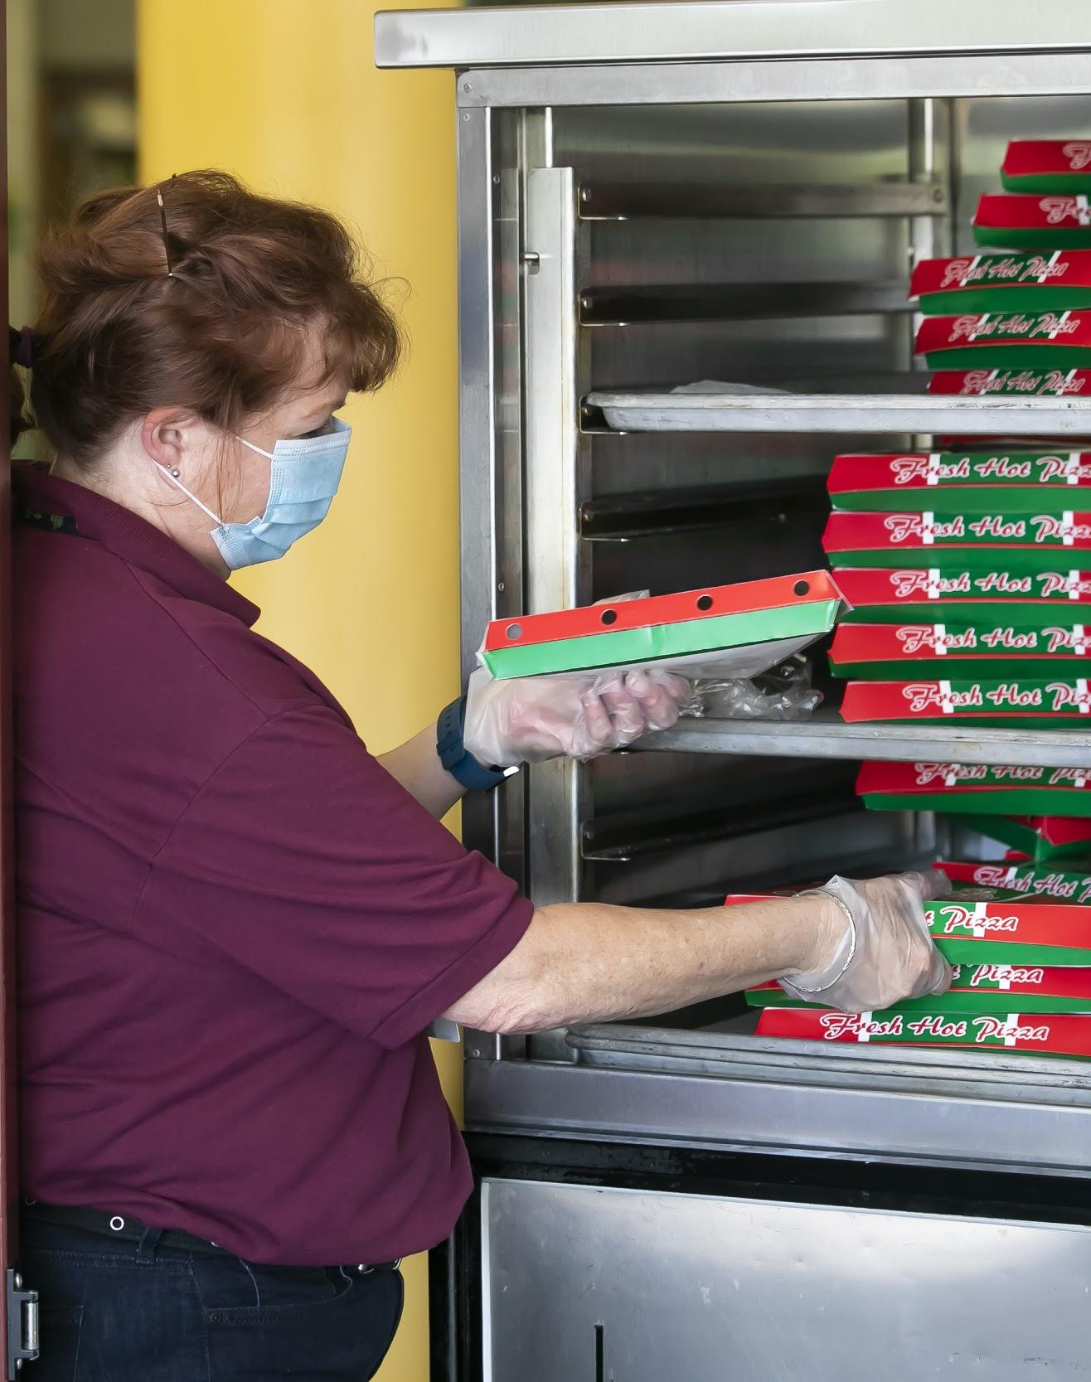
학교 급식 서비스
바로 가져갈 수 있는(Grab-and-Go) 급식 서비스
조식: 오전8시-9시
점심: 오전10:45-오후12:45
(Burleigh Manor 중학교 & Hammond 고등학교를 제외한) 모든 HCPSS 학교들에서 주중에 픽업 가능
자격 여건에 따라 가격 다름(무료, 할인, 또는 전액)
* 학생들은 어느 곳에서든 급식을 픽업할 수 있습니다
Notes:
The food services program during the Virtual Instructional Model in the first semester of the 2020-2021 school year will include Grab-and-Go meals to be offered at all school sites except Burleigh Manor MS and Hammond HS due to construction. For convenience, meals may be picked up at any location where meals are being served. Students/parents are encouraged to pick up meals at their home school site whenever possible.
Meal sites will operate Monday through Friday, based on the eligibility status (free, reduced-price, or paid).
Food and Nutrition Services will issue new income eligibility guidelines and FARMS application forms for the 2020-2021 school year, and households will be strongly encouraged to complete and submit applications online.

Slide 24
가정에서 수업 지원하기
HCPSS는 가정 환경에서 온라인 수업으로 전환하는데 있어서 가족들을 지원하기 위한 최상의 실행을 제공하고자 합니다.
https://www.hcpss.org/2020-2021/supporting-instruction/
Notes:
The HCPSS website provides several best practices to support families in transitioning to virtual instruction in the home environment.

Slide 25
기기 확보하기
크롬북이나 인터넷 연결이 필요함을 규명하기 원하시면:
부모님/가디언은 HCPSS Connect로 로그인하셔야 합니다.
왼쪽 메뉴 맨 마지막에 보이는“More Options”를 택한 후 화면 중앙에서 “Student Technology” 를 선택하십시오.
HCPSS Student Technology 화면에서, 드롭다운 화살표를 사용하여 각 학생에 대한 테크놀로지 신청(Technology Requested)을 표시합니다. 변경 내용은 즉시 저장됩니다.
기기가 이미 발급되었으면 인벤토리 목록에 나타날 것입니다. 만약 학생에게 기기가 이미 보급된 경우에는 새로운 신청이 진행되지 않습니다.
가정에서는 픽업 장소와 날짜 및 시간 등이 포함된 정보가 담긴 확인 이메일을 받게됩니다.
Notes:
HCPSS is able to purchase a sufficient amount of devices necessary to eventually achieve a 1:1 student-to-device ratio for all students in grades pre-K through 12. Due to vendor delays, order fulfillment will not arrive as expected and HCPSS is adjusting its device distribution plan.

