Slide 1
Bienvenido a la
Noche de regreso
a la escuela
Ellicott Mills Middle School
Notes:
Cover slide [insert school name]

Slide 2
VISIÓN: Cada estudiante y miembro del personal acepta la diversidad y posee las habilidades, el conocimiento y la confianza para influir positivamente en la comunidad en general.
MISIÓN: El HCPSS garantiza el éxito académico y el bienestar socioemocional de cada estudiante en un entorno inclusivo y acogedor que cierra las brechas de oportunidades.
VALUE
ACHIEVE
EMPOWER
CONNECT
Más información: www.hcpss.org/scta
Notes:
Superintendent Michael Martirano has established a bold Strategic Call to Action to guide our school system. “Learning and Leading with Equity” is a strategic plan for building an instructional program to enable every student to reach their greatest potential.
HCPSS is focusing our resources and priorities to make certain that every child graduates from high school and is prepared for the world of work and ready to enter college.
The Strategic Call to Action embodies four commitments to each student, staff member, parent, and community member:
We VALUE every stakeholder, whether student, employee, parent, or community member.
We commit to ACHIEVEMENT by supporting every person in our system - both students and staff - in reaching milestones for personal growth that are appropriate to their goals and strengths.
We CONNECT with students, parents and community members in ways that nurture and restore.
We EMPOWER schools, employees, families, and community members to actively support student achievement and well‐being.

Slide 3
Noticias e información de las escuelas y el Sistema
Correo electrónico
Texto
Noticias escolares,
HCPSS News, avisos de emergencias
Solo avisos urgentes/de emergencia
Sitio del HCPSS
Sitio de la escuela
XXXX.hcpss.org
www.hcpss.org
Noticias y recurso de información de todo el sistema escolar
Noticias de la escuela, calendario, deportes y clubes, directorio escolar y más
Notes:
[Fill in on slide (lower right): your school name & web address initials]
Parents receive news and announcements from our school and system via the HCPSS News service. Parents are automatically registered for this service. Email messages are delivered to the contact information that you provide in the Family File.
Parents receive via Email:
School newsletters & other communications
Major system-level announcements
HCPSS News weekly newsletter, providing news and upcoming events.
Emergency notifications (school closings/delays).
Text messages: Parents have the option to receive text messages. Texts are sent only for urgent/emergency announcements (school closings and delays, etc.)
New parents are sent a text message to opt-in for text alerts. If you didn’t receive this, visit www.hcpss.org/hcpss-news/ to troubleshoot.
Text alerts will be sent to the mobile phone number identified in Family File.
If you were opted-in to receive text messages last year, and your phone number has not changed, you do not need to opt-in again.
Our school website is a one-stop destination where you can quickly find:
School calendar, announcements and news
Student activities, sports, clubs
Services including school meals
Staff directory and email links
Quick Links to HCPSS Connect, system website, and other resources for students and parents

Slide 4
Redes sociales
[Nombre de la escuela] Twitter: @hcpss_xxxx
Facebook del HCPSS : www.Facebook.com/HoCoSchools
Twitter del HCPSS: www.Twitter.com/HCPSS
Instagram del HCPSS: instagram.com/hocoschools
Flickr del HCPSS: flickr.com/photos/hcpss
Twitter del Superintendente: https://twitter.com/mjmsuper
Notes:
[insert school name & Twitter handle on slide if actively using it; remove 1st line if not]
Link to our social media sites:
Get up-to-the-minute updates, news, student and school happenings, and announcements
Interact with the school and system

Slide 5
Correo electrónico semanal del sistema
Noticias y anuncios del sistema escolar
Eventos venideros
Oportunidades para compartir opiniones sobre normas y decisiones del HCPSS
Notes:
Watch your inbox for HCPSS News each week throughout the school year.
The HCPSS News weekly email is your source for announcements of
Upcoming school system programs and events
Public Hearings and other opportunities to share input and feedback
Opportunities to participate on school system committees
Boundary Review updates, and other important information.
All parents are automatically subscribed to HCPSS News.

Slide 6
Aplicación móvil del HCPSS
Descarga gratuita en el App Store:
iPhone
iPad
Android
Notes:
The HCPSS Mobile App is available free to download for iphones, iPad, and Android devices in the app stores (search for “HCPSS”).
The app makes it quick and easy to find the information you need, when you need it. It provides:
Messages and calendar dates from all of the schools that your children attend, as well as school district information.
School menus
Simplified access to information and quick links

Slide 7
Cierres/demoras escolares
www.HCPSS.org
@hcpss
HCPSS News
HoCoSchools
HCPSS Status
Línea directa
status.hcpss.org
410-313-6666
Notes:
School Delays and Closings (usually weather-related) are communicated through several information sources:
HCPSS homepage: www.hcpss.org - this is the first and most complete source of information
HCPSS News emails and texts (as described on earlier slide)
Social media: Twitter (@hcpss) & Facebook (HoCoSchools)
HCPSS TV – channel 42 (Verizon) and 72 (Comcast)
HCPSS Information Hotline recording – 410-313-6666

Slide 8
Salud mental y apoyos para estudiantes
Consejero/a Escolar: Rachel Schwaab – Last Names A-G
(rachel_schwaab@hcpss.org)
Shanté Owens-Young – Last Names H-O
(shante_owens-young@hcpss.org)
Grace Burnett – Last Names P-Z
(grace_burnett@hcpss.org)
Psicólogo/a Escolar : Mary Kate Dorval (marykate_dorval@hcpss.org)
Enlace para el Logro Internacional: Sung Kim (sung_kim@hcpss.org)
Más información: www.hcpss.org/supports/mental-health-wellness
Notes:
Replace [school name] and names/contact info (phone and/or email) for your school’s student support staff members (add/delete titles as needed)
The mental health and well-being of our students is very important to us. Staff are available to support students and families. These staff work with all students to develop their unique strengths and abilities.
Each of these staff members wants to work with parents to best support your child. Please do not hesitate to contact them with questions or concerns.
The “Mental Health and Wellness” page on the HCPSS website provides many valuable resources for all families. Search for “mental health” at www.hcpss.org.

Slide 9
Sistema de información del estudiante Synergy
Sistema de aprendizaje Canvas
Archivo Familiar
www.hcpss.org/connect
Notes:
HCPSS Connect is the one-stop portal to access Synergy, Canvas, and the Family File.
The Synergy Student Information is your source for official student records & grades.
The Canvas Learning System gives teachers, parents, and students tools to communicate, collaborate, and connect.
Both systems are extremely easy to learn and to use.
Benefits of HCPSS Connect for Parents, Students & Teachers:
Improved communication and collaboration
All schools and grades use the same digital platform
Single sign-on - 1 user/pass for HCPSS Connect
Anytime/anywhere access
Find full details and instructions online at www.hcpss.org/connect

Slide 10
Actualice la información del estudiante
Información de contacto de padres
Datos y contactos médicos
Transporte después de la escuela
Preferencias de privacidad de datos
Formularios de participación en [actividades] atléticas
www.hcpss.org/connect
Notes:
The Family File on HCPSS Connect provides important information about your student. All information is confidential.
It is important that parents update the Family File each year with current data about your student including:
Parent emails and phone numbers
Student medical contact data
After-school transportation options
Data privacy options
Links to the application for the Free and Reduced Meals program
Log into HCPSS Connect and click the My Account tab. Save your changes by clicking the Update Account button.
Parents can make changes in the Family File at any time during the year.
Parents without online access can provide this information through a paper “Emergency Procedure and Confidential Student Information” form. Contact the school office for a copy of this form.
Athletic participation forms can be completed online in Synergy.

Slide 11
HCPSS Connect: Cómo obtener ayuda
Asistencia para iniciar sesión:
Contáctese con la
oficina escolar
Guías y recursos:
www.hcpss.org/connect
Notes:
Parents will continue to use the same login credentials as in prior years.
Parents of students new to HCPSS will receive their login information via US Mail.
For help with your login or password: call the School Office
For help in using Canvas, Synergy, or the Family File, see the many guides and resources on the HCPSS Connect homepage (www.hcpss.org/connect), or contact the school office.

Slide 12
Canvas: Qué esperar
Página principal del curso:
Descripción general
Información sobre privacidad del estudiante
Recursos
Fechas del calendario/eventos
Anuncios
Formación de habilidades del estudiante (apropiada al grado)
CANVAS
¿Tiene preguntas sobre Canvas? Haga clic en la caja de Orientación (Orientation)en la página principal de Canvas para acceder a las Gúias para padres (Parent Guides)
Notes:
Canvas is HCPSS’ Learning Management System. In elementary school, teachers primarily use Canvas to share general course information and resources, send out announcements, and share calendar events. Your child’s classroom teacher may publish their individual ELA or Math courses, or they may work as a grade-level team and share information from the grade-level page. In upper-elementary grades, your child’s teacher may use more of Canvas’s other tools, such as online discussion boards, quizzes, and digital assignment submissions.
CANVAS EXPECTATIONS for teachers:
Each Canvas course will have the following:
Course homepage
Overview - Information about the course and teacher or about the grade-level team
Student privacy information - Information on homepage or grade level page regarding teachers’ use of recording devices and digital tools for school-related activities
Resources - Links to instructional tools or resources for families
Calendar dates - Share class/grade specific dates and events with families and students using the Canvas calendar
Announcements – Teachers will communicate timely information with students and families using announcements either through the teacher course or grade level course. By default, announcements will be sent to parent’s primary email in Family File
In addition, teachers will help students develop their Canvas and online learning skills with grade-appropriate activities.
Parents can learn more about how to use Canvas by going to the Canvas Orientation course (link at the top of the Canvas homepage). There, they can learn how to navigate Canvas and change their notification preferences.

Slide 13
Menúes escolares interactivos
Descripciones de alimentos
Nutrición y alérgenos
Recuento de carbohidratos
Enlaces para pre-pago
Enlace para la solicitud de FARMS
Menúes de desayuno y almuerzo
http://hcpss.nutrislice.com
App gratis para iPhone o IOS
App móvil del HCPSS
Notes:
HCPSS offers online school menus through a website and mobile app by Nutrislice.
The interactive menus provide access to up-to-the-minute content anytime, anywhere.
The innovative school menu site features nutrition and allergen information for all Howard County school meal items, both breakfast and lunch, and includes:
Carb counts
Allergen filters
Food descriptions and photos
Menu item rating system
Links to MySchoolBucks pre-payment options
Monthly menu email subscription sign-up
And more
Menus are available in several languages: English, Spanish, Korean, Chinese, and French.
Options for using the interactive menus:
Online: hcpss.nutrislice.com
Download the free app, “School Lunch by Nutrislice,” in the Google Play or App stores.
Select the “Menus” icon on the HCPSS mobile app

Slide 14
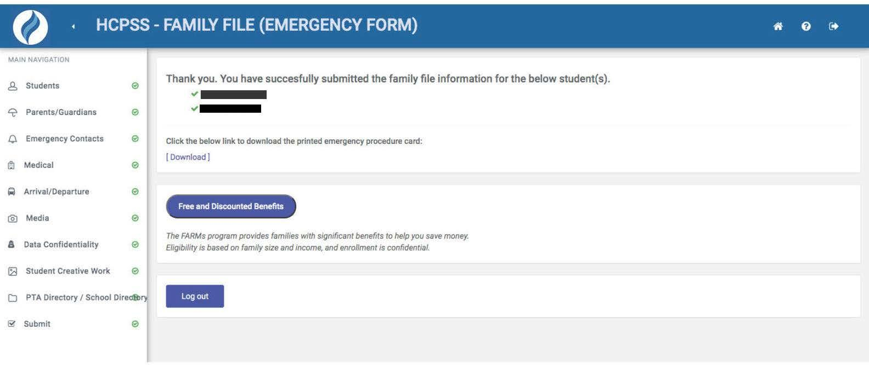
Comidas gratis y a precio reducido (FARMs)
Las familias que califiquen pueden recibir a costo reducido o gratis:
Comidas escolares
Seguro médico
Matrícula para HCC
Tasas de exámenes SAT, ACT y AP gratis
Campamentos, deportes, cuidado infantil
Muchos otros beneficios
Notes:
HCPSS participates in the National School Lunch and Breakfast Programs.
The Free and Reduced Price Meals program (FARMs) helps many families save money in many ways including free or lower prices for:
School breakfast and lunch
HCC tuition
SAT, ACT and AP exam fees
Camps, sports and child care
And many other programs and services
More information and the online application can be accessed at the completion of the Family File process.

Slide 15
Comidas gratis y a precio reducido (FARMs)
Paso 1: Visite www.hcpss.org/farms/
Paso 2: Haga clic en “Apply Online” para iniciar el proceso de inscripción en línea
SITIO DEL HCPSS
SOLICITUD
Cómo presentar una solicitud
Envíe solo una solicitud por grupo familiar. Las familias que necesitan asistencia con computadora o con el idioma para presentar una solicitud en línea, comuníquense con la escuela de su niño. Ver las pautas de requisitos de ingresos federales.
En línea
Después de que se haya enviado y revisado la solicitud en línea, las notificaciones de elegibilidad se enviarán por correo electrónico o por correo.
Para empezar
Lo que deberá proporcionar durante el proceso de solicitud:
El nombre y los ingresos actuales de cada miembro de su grupo familiar
La escuela y el grado de cada estudiante en su grupo familiar
Su firma electrónica
(Opcional) Una dirección de correo electrónico válida o un número de teléfono para la comunicación del distrito sobre el estado de la solicitud
Si está listo para comenzar, haga clic en el botón a continuación para comenzar el proceso de solicitud en línea.
ENVIAR SOLICITUD EN LÍNEA
(IDIOMAS ADICIONALES DISPONIBLES)
INICIE EL PROCESO DE SOLICITUD EN LÍNEA

Slide 16
Guías Lo que su niño aprenderá
En Canvas a través de HCPSS Connect
Descripción del contenido del plan de estudios para cada
Grado (Pre-K a 5º)
Asignatura
www.hcpss.org/connect
Notes:
What Your Child Will Learn guides provide an overview of the instructional program for your child’s grade, as well as student goals and expectations. The guides include information to help parents monitor and support their child’s progress during the school year.
Individual guides are provided for each grade level. The guide identifies the content covered in each curriculum area, categorized by subject, e.g., Language Arts, Science, etc.
Find the guides online in Canvas. (The guides are available online only; print versions are no longer distributed.)
The guides provide general information about curriculum content. Specific student programs may differ, depending on instructional needs.

Slide 17
Instrucción otoño 2020-2021
Información y actualizaciones:
www.hcpss.org/2020-2021/
Respuestas a preguntas frecuentes:
help.hcpss.org
Notes:
SCHOOL ADMINISTRATORS SHOULD CHECK ON THE HCPSS WEBSITE FOR UPDATES TO ALL OF THE FOLLOWING SLIDES BEFORE YOUR BTSN FOR UPDATES TO THIS INFORMATION. https://www.hcpss.org/2020-2021/
Detailed information about all aspects of the fall instruction program is provided on the HCPSS website.
You can find the answers to many questions on the help site: help.hcpss.org. The site is keyword searchable.
Check back frequently, as these sites are regularly updated with new information.

Slide 18
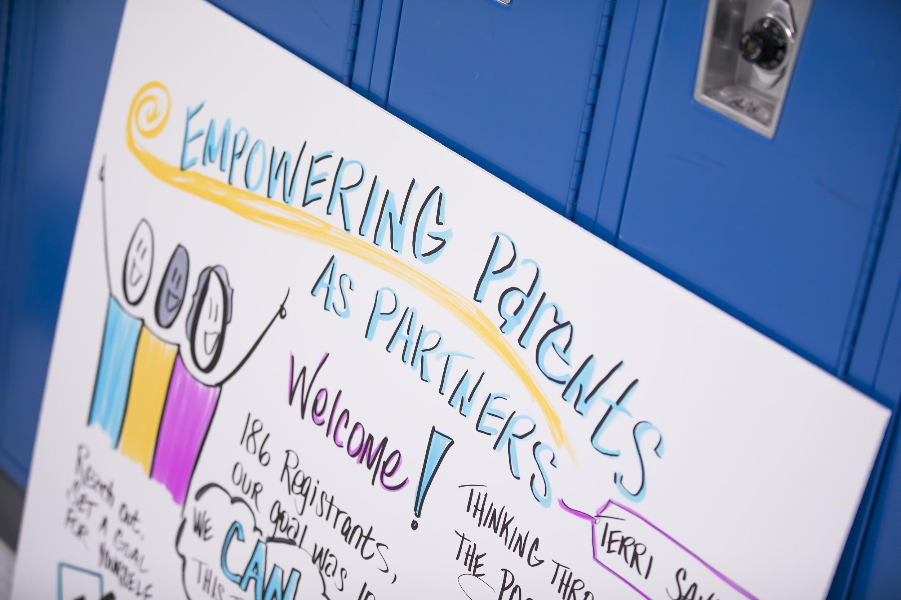
Recursos comunitarios
Varias organizaciones en el Condado de Howard ofrecen servicios y recursos para estudiantes y familias.
www.hcpss.org/community-news-and-programs/
Notes:
There are several organizations in Howard County that offer services such as child care, tutoring and other supports and resources for students and families.

Slide 19
Muestra de horario de instrucción virtual
Muestras de horarios pueden encontrarse en línea
www.hcpss.org/2020-2021/
Notes:
Students in grades K-5 will engage in synchronous lessons four days a week via Google Meet in Social Emotional Learning (SEL), language arts and mathematics.
Students will engage in content (science, social studies and health) via Google Meet two days each week.
Elementary students also will engage in related arts synchronous lessons via Google Meet two days each week.
Elementary students will engage in synchronous lessons 2.5-3 hours on each of the four synchronous days.
For each synchronous lesson, students are expected to participate in the lesson, respond to questions and participate in class activities.
In addition, students in grades K-5 will engage in asynchronous assignments, (e.g. independent reading, writing assignments, mathematics tasks and eLearning experiences with Lexia Core5 and DreamBox) for 8-9 hours each week.

Slide 20
Asistencia
Lunes, martes, jueves y viernes
El maestro del salón de clases de escuelas primarias (K a 5º grados) y el maestro de matemáticas toman asistencia
La asistencia de escuelas intermedias (6º a 8º grados) y secundarias (9º a 12º grados) se toma en cada clase
Miércoles (completar al menos un elemento durante la semana)
Entregar tarea a un maestro
Participar en instrucción sincrónica con un maestro del HCPSS
Completar trabajo en el sistema de administración de aprendizaje Canvas, DreamBox o Lexia Core5
Notes:
At the elementary level, student attendance for Monday, Tuesday, Thursday and Friday instruction will occur by both the homeroom teacher and mathematics teacher taking attendance, noting whether students were present online for synchronous instruction.
Daily attendance will be based on teacher-recorded attendance for the entire school day.
If there is technical difficulty, a student may submit asynchronous work for a particular day to receive credit for attendance.
For Wednesday, a student will be counted as present if they do one or more of the following at some point during the week:
Submit an assignment to one of their teachers
Engage in synchronous instruction or tutoring with an HCPSS teacher
Meet online with an HCPSS teacher or service provider
Complete work in the Canvas learning management system, DreamBox or Lexia Core5

Slide 21
Calificación
La calificación de estudiantes continuará según las prácticas tradicionales de calificación.
Los padres deben revisar Canvas para actualizaciones sobre el desempeño.
Notes:
Student grading will follow the same traditional grading practices as followed during a typical school year.
Grading practices are outlined in HCPSS Policy 8010 – Grading and Reporting: Pre-Kindergarten Through Grade 5 and HCPSS Policy 8020 - Grading and Reporting: Middle and High School.
Staff are currently determining policy adjustments that may be needed for virtual instruction.

Slide 22
Servicios de educación especial
El equipo del IEP o IFSP de cada estudiante, el cual incluye al padre, conversará cómo el plan actual del estudiante se implementará para el 2020-2021.
Los planes de continuidad de aprendizaje individualizado (ICOL) ya no se usarán.
Los padres serán contactados al inicio del año escolar sobre la mejor manera de proporcionar servicios a su niño en un entorno virtual.
Notes:
A significant amount of thought and detail have been focused on ensuring that special education services and supports are provided to the greatest extent possible for students across all levels and schools.
Each student's Individualized Education Program (IEP) or Individual Family Service Plan (IFSP) team, which includes the parent, will be participating in meaningful discussions to implement the student’s current plan and not on the previous individualized continuity of learning, or ICOL, plans.
Parents should expect their child’s case manager to contact them at the start of the school year to collaborate on how best to provide services for their child in a virtual environment.

Slide 23
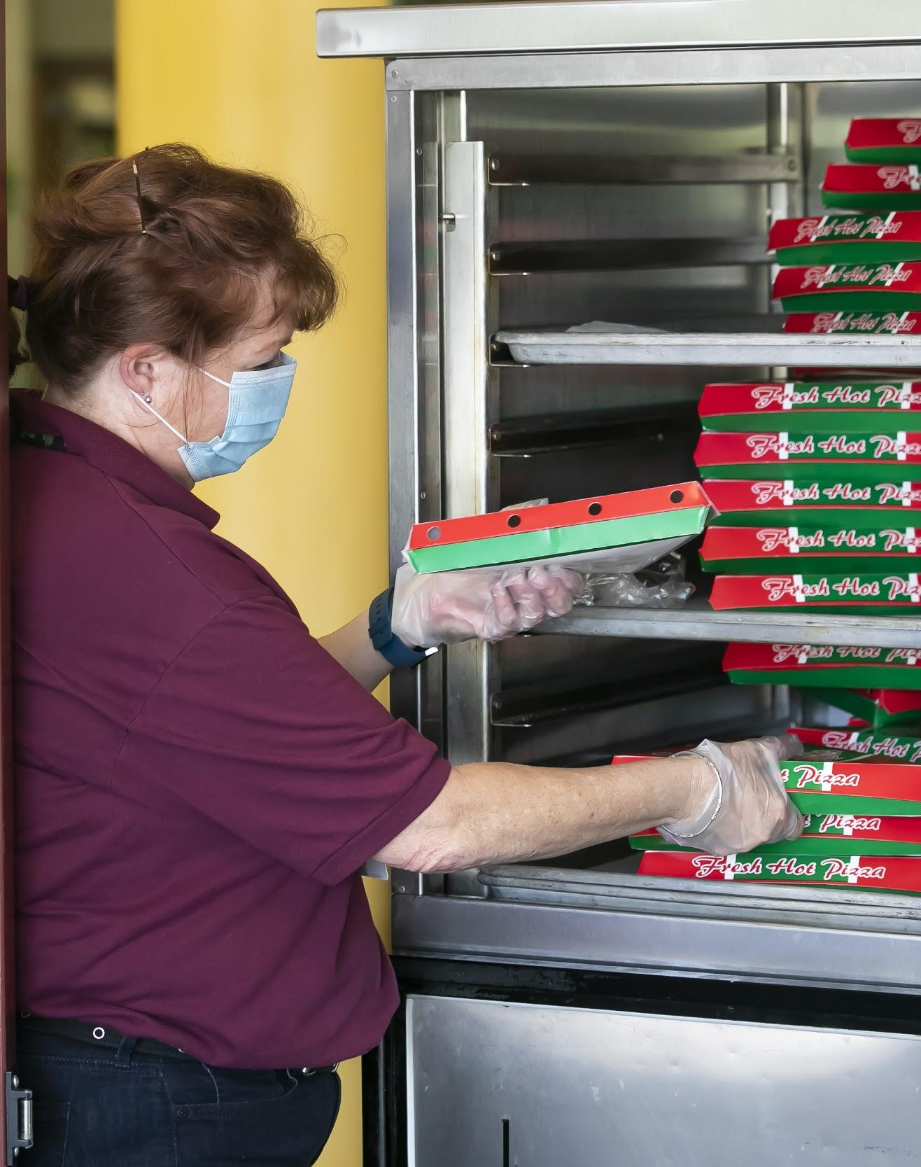
Servicios de comidas escolares
Servicio de comidas listas para llevar (Grab-and-Go)
Desayuno: de 8am a 9am
Almuerzo: de 10:45am a 12:45pm
Días de semana en todas las escuelas del
HCPSS (excepto Esc. Interm. Burleigh Manor y Esc.
Secund. Hammond)
Precios en base al estado de elegibilidad
(gratis, precio reducido o sin descuento)
*Los estudiantes pueden recibir comidas
en cualquier localidad
Notes:
The food services program during the Virtual Instructional Model in the first semester of the 2020-2021 school year will include Grab-and-Go meals to be offered at all school sites except Burleigh Manor MS and Hammond HS due to construction. For convenience, meals may be picked up at any location where meals are being served. Students/parents are encouraged to pick up meals at their home school site whenever possible.
Meal sites will operate Monday through Friday, based on the eligibility status (free, reduced-price, or paid).
Food and Nutrition Services will issue new income eligibility guidelines and FARMS application forms for the 2020-2021 school year, and households will be strongly encouraged to complete and submit applications online.

Slide 24
Apoye la instrucción en su casa
El HCPSS ofrece las mejores prácticas para apoyar a las familias durante la transición hacia la instrucción virtual en el entorno de la casa.
https://www.hcpss.org/2020-2021/supporting-instruction/
Notes:
The HCPSS website provides several best practices to support families in transitioning to virtual instruction in the home environment.

Slide 25
Cómo obtener un dispositivo
Para identificar su necesidad de un Chromebook o Internet:
Los padres/tutores deben iniciar sesión en HCPSS Connect.
En el menú de la izquierda, la última opción, seleccionar “More Options” (Más opciones) y después seleccionar “Student Technology” (Tecnología del estudiante) del centro de la pantalla.
En la pantalla de HCPSS Student Technology, use las flechas desplegables para indicar la Tecnología requerida (Technology Requested). Los cambios se guardan de inmediato.
Si ya se emitió un dispositivo, aparecerá en la lista de inventario. Si un estudiante ya cuenta con un dispositivo emitido, no se procesará un pedido nuevo.
Las familias recibirán un correo electrónico de confirmación con la información necesaria, con la inclusión de localidad, fecha y horario para recogerlo.
Notes:
HCPSS is able to purchase a sufficient amount of devices necessary to eventually achieve a 1:1 student-to-device ratio for all students in grades pre-K through 12. Due to vendor delays, order fulfillment will not arrive as expected and HCPSS is adjusting its device distribution plan.

